Slide 1

Zillow Home Values
Project 1

Slide 2




Contributors
Walter Hampson
Michael Haile
Drew Kirke
Kortney Cose

Slide 3


Background
Wednesday, February 13,2024
The purpose of this project is to analyze home prices based off Zillow data to determine trends and predict future pricing. The data introduced is intended to allow you to correlate home prices to different economic indicators.

Slide 4




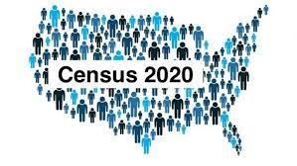
Data Utilized
Zillow home pricing data
https://www.zillow.com/research/data/
FRED
https://fred.stlouisfed.org/
US Census
https://www2.census.gov/geo/docs/reference/ua/

Slide 5

Home Prices and Economic Indicators

Slide 6
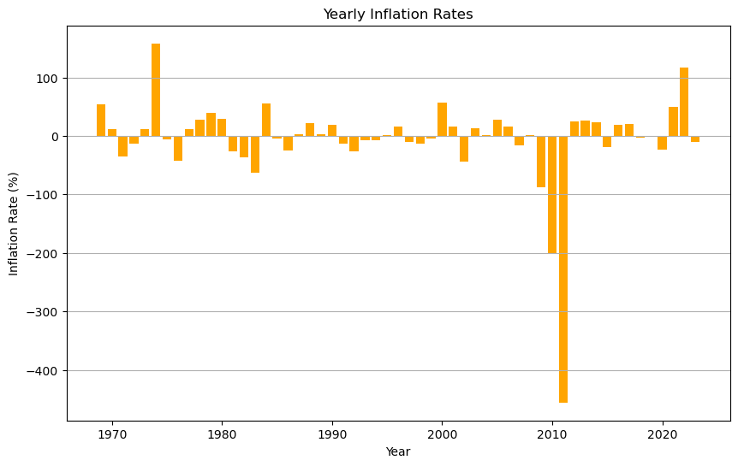
Yearly Inflation Rates

Slide 7
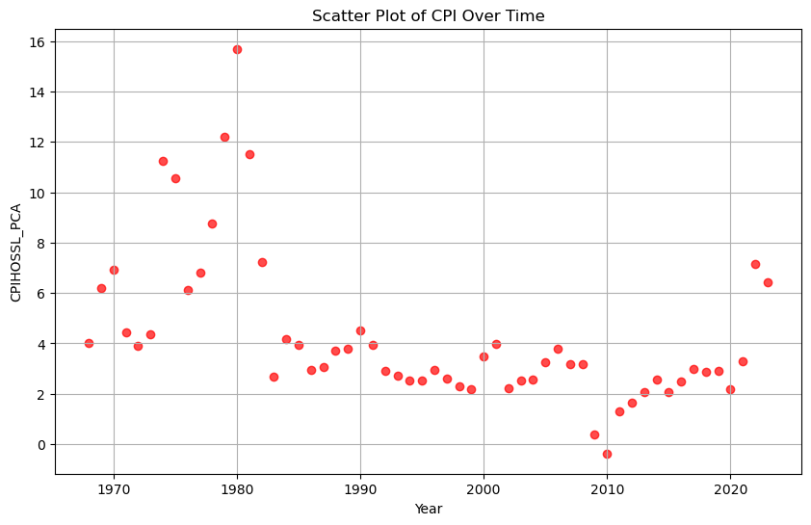
CPI Over Time

Slide 8
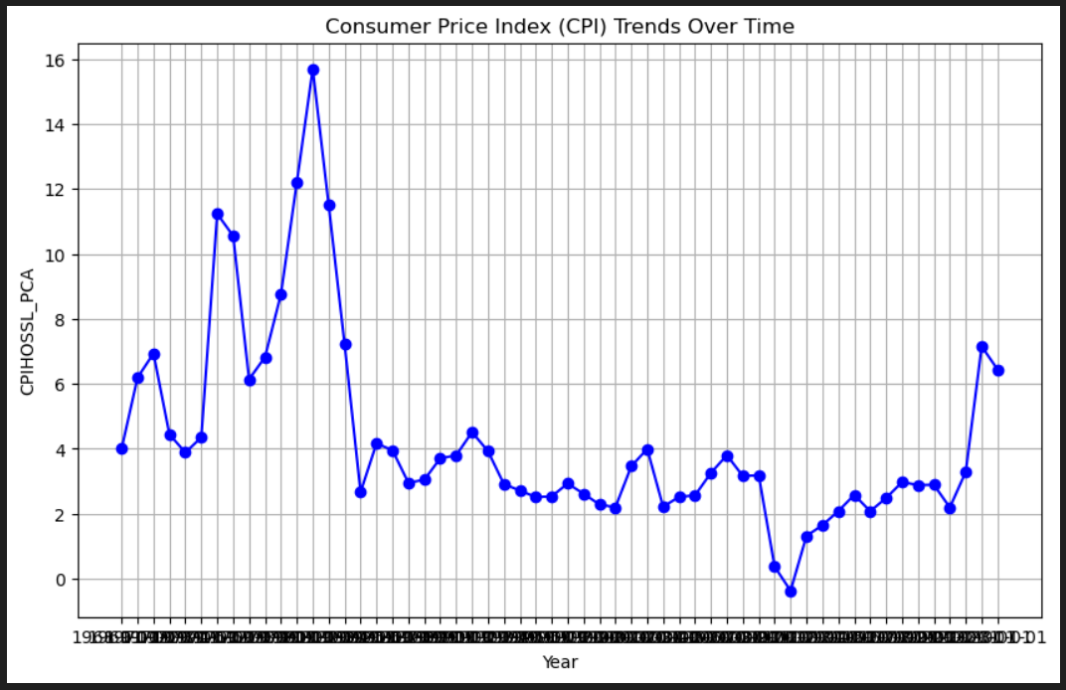
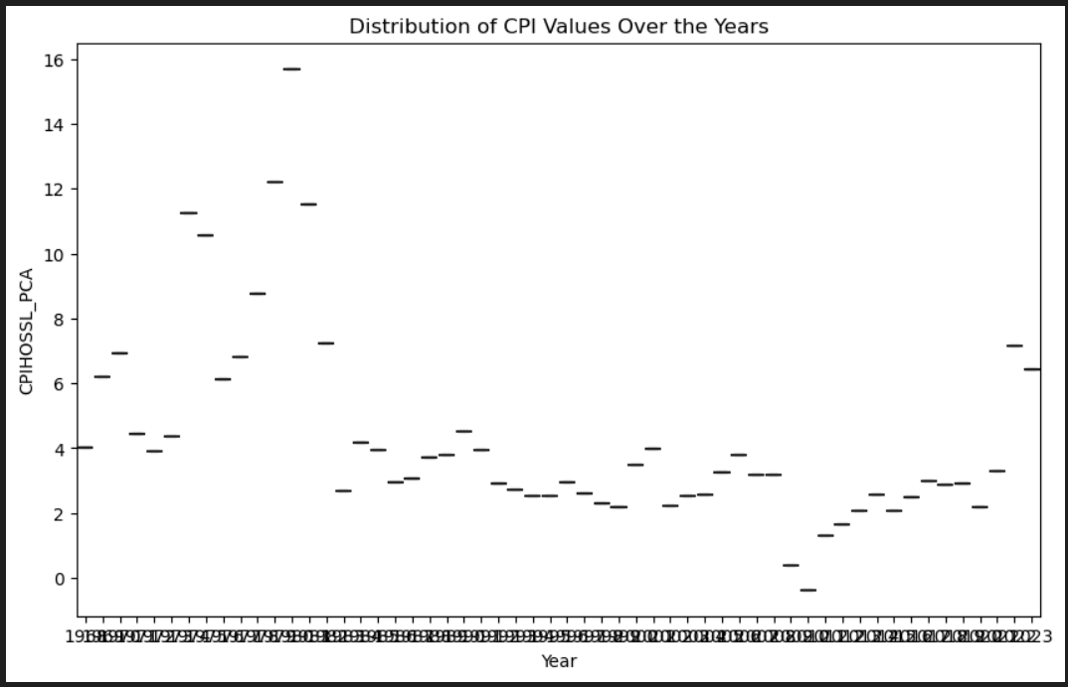
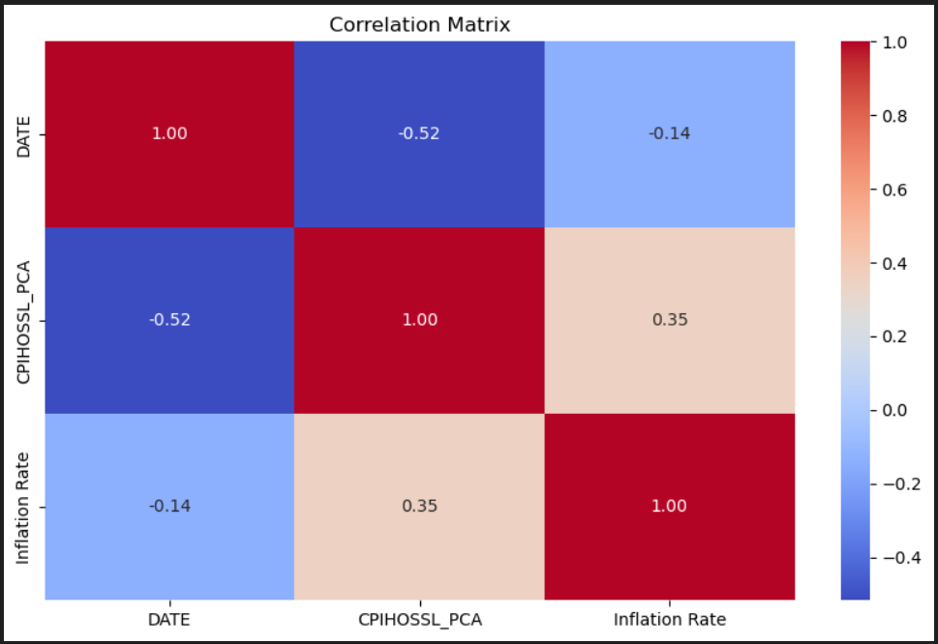
EDA Of the challenges we faced the largest was by far merging the data by date for all CSV files to line up correctly.

Slide 9
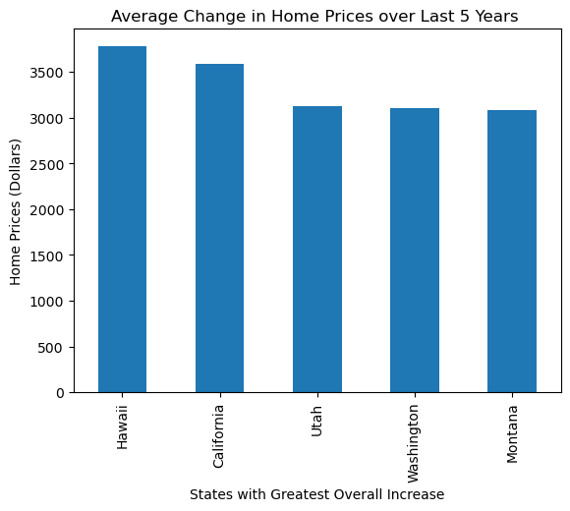
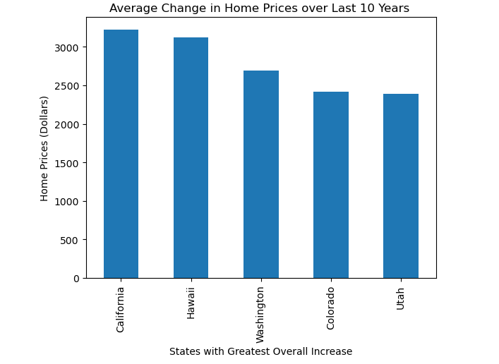

Slide 10
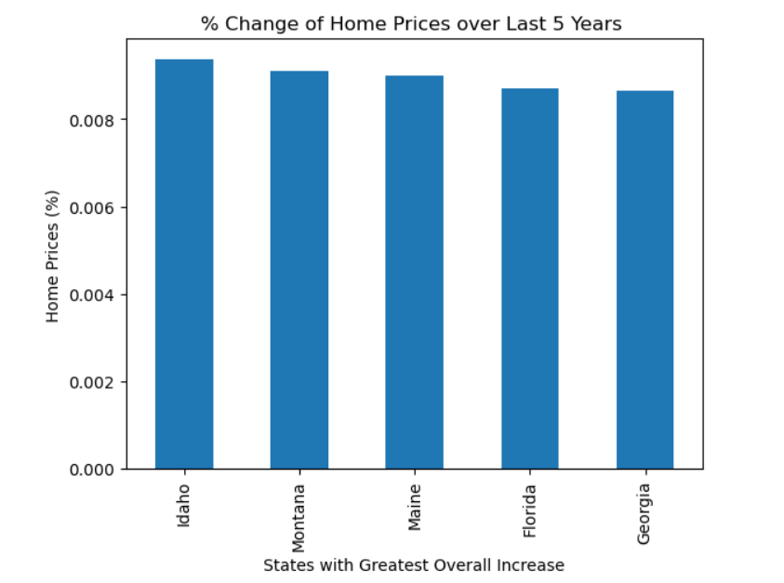
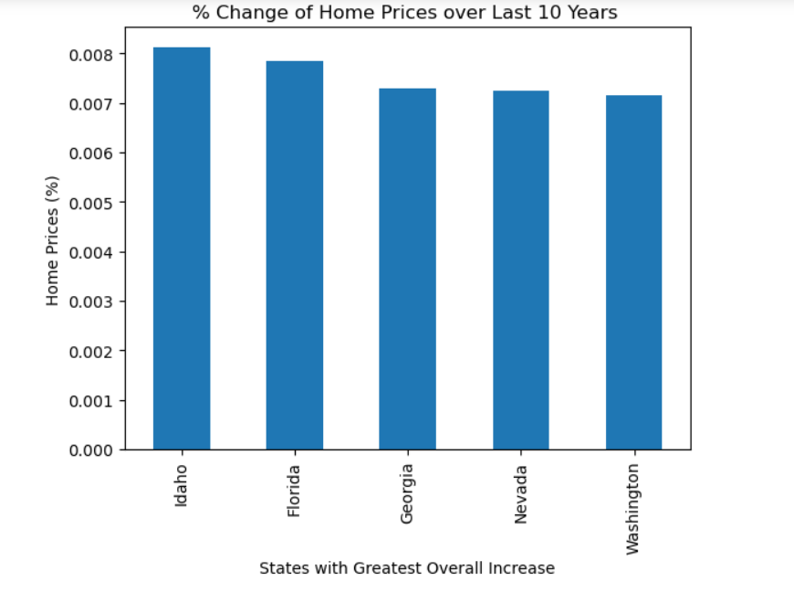

Slide 11
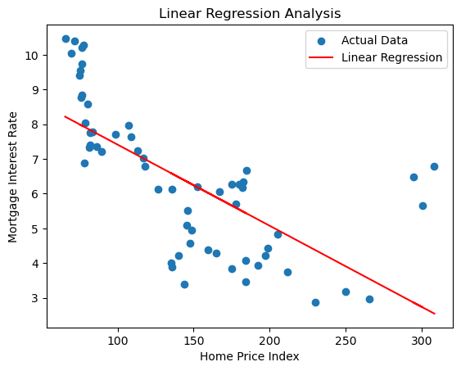

Home Price Regression

Slide 12

Conclusion
Which states have the greatest increase of home pricing within the last 5 years? Hawaii, California, Utah, Washington, and Montana. 10 Years? California, Hawaii, Washington, Colorado, and Utah.
How does inflation influence overall home pricing? Inflation has a direction influence on over home prices. You will expect to see similar trends in inflation and home pricing.
What type of relationship do interest rates have to home pricing? As seen within the regression chart above these variables share an inverted relationship Higher interest rates may lead to decreased affordability, potentially causing a decrease in home prices.
What is the average change in home prices in the US within the last 5 years? .32% 10 years? .26%
Can we predict future home prices using a regression analysis? While we may not be able to predict exact home prices, we can assume that these trends will continue in the future and economic performance will be a good marker of where home prices may be.
After reviewing this project, you should be able to answer the following questions:

